Slide 1
Materi Pembelajaran
Deskripsi
Membahas mengenai pengetahuan dasar tentang PHP, Framework PHP, dan Laravel.
Membahas mengenai proses instalasi Laravel
Materi yang Akan Disampaikan:
PHP dan Framework PHP
Instalasi Laravel
Tugas :
Instalasi Laravel
Akses hasil instalasi Laravel
Learning Outcome
Mahasiswa mampu melakukan instalasi dan pengaturan dasar framework pengembangan aplikasi

Slide 2
Tools and definition
HTML (HyperText Markup Language) is the standard markup language for documents designed to be displayed in a web browser.
PHP (Hypertext Preprocessor) is used to create dynamic content that interacts with the databases of the applications.
PHP Framework Help the developers to promote RAD (Rapid Application Development) for saving time, building more stable applications, and reducing repetitive coding.
JavaScript is a text-based programming language used both on the client-side and server-side that allows you to make web pages interactive
CSS (Cascading Style Sheets) is a style sheet language used for describing the presentation of a document written in a markup language such as HTML.

Slide 3
PHP Framework

Slide 4

Developer(s) Taylor Otwell
Initial release June 2011
Stable release 8.16.1[2]
Written in PHP
Web framework
MIT License

Slide 5
Why laravel
MVC architecture and OO approach to enhance the performance
Built-In Authentication and Authorization
Artisan CLI for simple and fast commands
The Eloquent ORM
Blade Templating Engine for stunning layouts
Testing Automation For Test Driven Development
Clean And Simple Routing
Security
Elegant Dependency Injection and Dependency Management
Great Tutorials and Documentation
Active Community

Slide 6
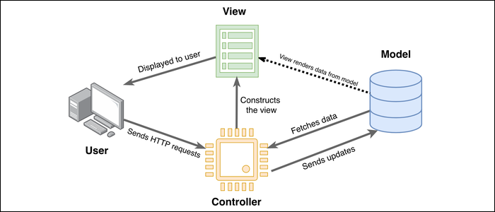
MVC
Model : represents the shape of the data your application operates on.
Controller : interacts with this model. Talks and updates to the model (database) and retrieves the info. The controller contains most of the logic for your application.
View is a template with which the model can be plugged into and displayed, and it can be manipulated by the controller.

Slide 7
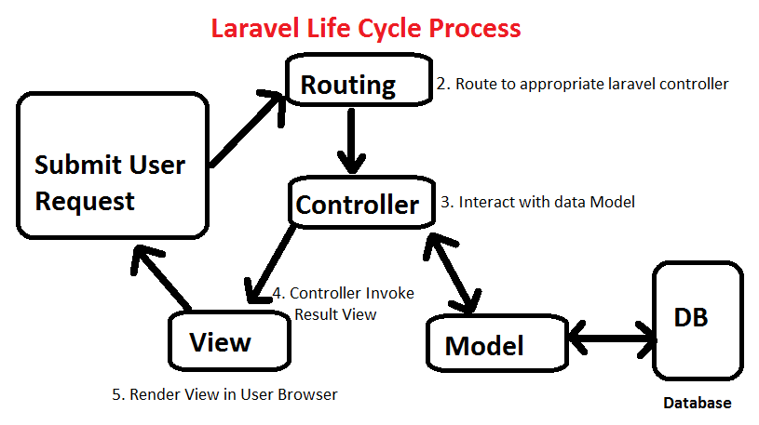
Notes:
https://augnitive.com/request-life-cycle-of-laravel-how-laravel-works-under-the-hoods/ The user input https://a-url.com/ in the browser and hits ‘enter’.
Once the user hit this URL, the browser will send the page request over the Internet to the web server (Apache or Nginx).
The web server will receive the request and analyze the request information. In the web server’s configuration file, the site’s root path is specified. Based on that, the web server will look for index.php file in that root directory, since URL doesn’t contain any subdirectory or any other routes.
Web server will direct the request to public/index.php file of laravel application.
In this step, PHP Interpreter is executing the code contained in the index.php file from the request. During this step, auto loader files which are generated by composer will be loaded.
Then it will create the laravel instance and bootstrapping the components of laravel.
The kernel will receive the request, load the service providers and will be redirected to router.
Router will render the view file content and return back to web server.
Web server receives the output from PHP and sends it back over the Internet to a user’s web browser.
The user’s web browser receives the response from the server, and renders the web page on user’s computer.

Slide 8
Installing Laravel prerequisite
Minimal PHP 7.3
Web server (apache, nginx, or else)
DBMS (MariaDB, MySQL, or else)
Composer 2
Terminal (CMD/Powershell/GitBash)
Code Editor (e.g. VS Code)+ Extensions

Slide 9
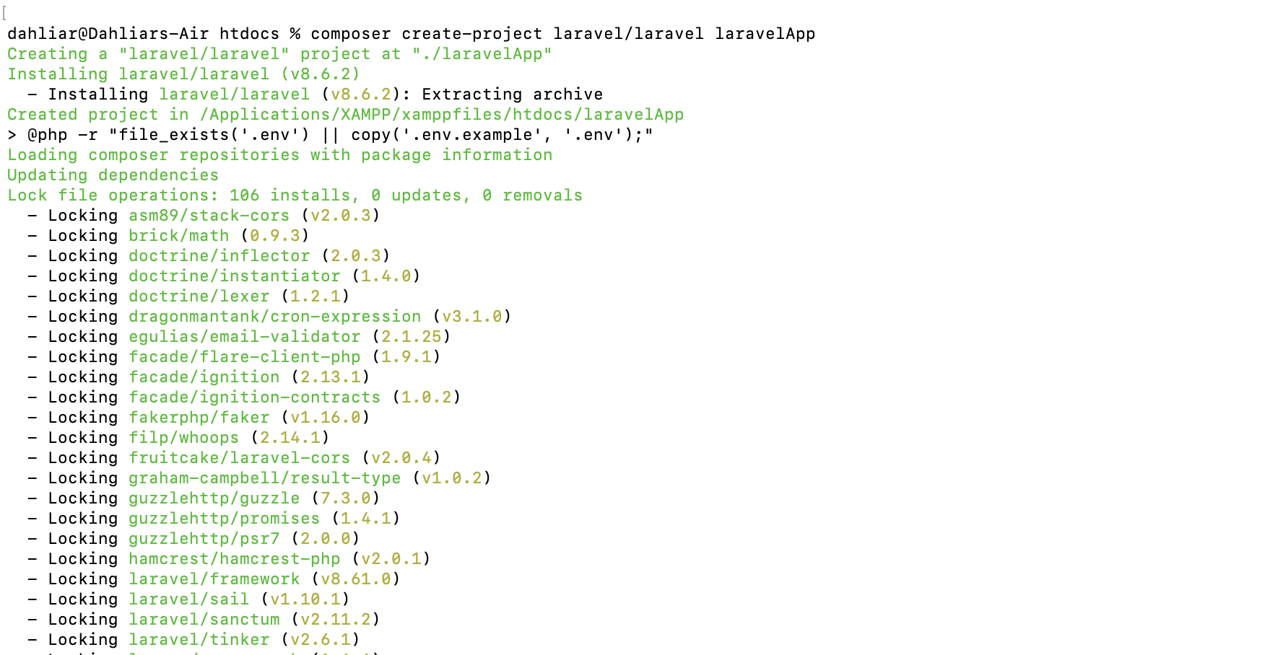
Installing laravel
Buka console/terminal arahkan ke root directory web server.
Eksekusi perintah :
composer create-project laravel/laravel laravelApp

Slide 10
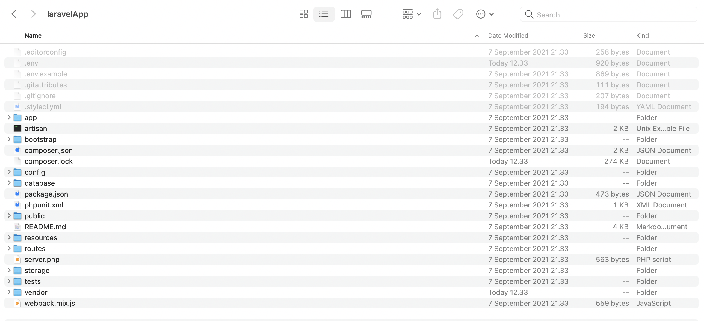
Installing laravel
Menghasilkan satu folder laravelApp

Slide 11
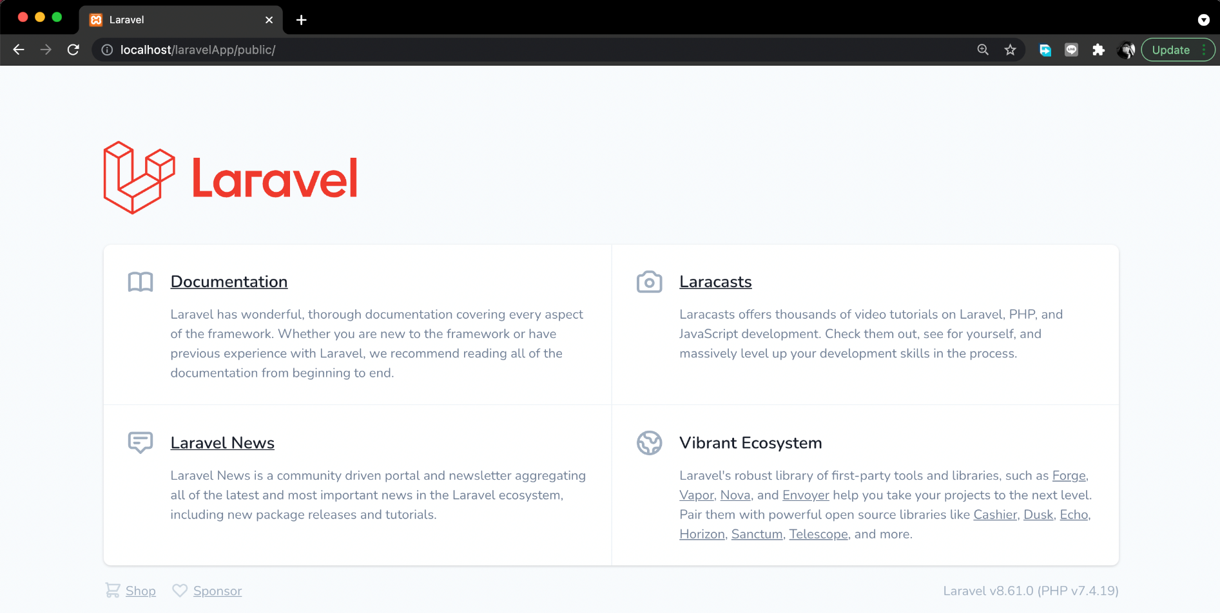
Installing laravel
Cek dengan menjalankan url : localhost/laravelApp/public

Slide 12
Laravel Important folder
Folder | Definitio
The App Directory | The app directory contains the core code of your application.
The Config Directory | The config directory, as the name implies, contains all of your application's configuration files
The Database Directory | The database directory contains your database migrations, model factories, and seeds.
The Public Directory | The public directory contains the index.php file, which is the entry point for all requests entering your application and configures autoloading. This directory also houses your assets such as images, JavaScript, and CSS.
The Resources Directory | The resources directory contains your views as well as your raw, un-compiled assets such as CSS or JavaScript. This directory also houses all of your language files.
The Routes Directory | The routes directory contains all of the route definitions for your application. By default, several route files are included with Laravel: web.php, api.php, console.php, and channels.php.

Slide 13
Assignment
Lakukan instalasi Laravel dan lakukan konfigurasi awal.
Cari cara untuk menjalankan aplikasi Laravel yang kita buat menggunakan Valet.

Slide 14

any question?

